Slide 1
Pedestrian Tracking by Combining YOLO And Active Contour
Yang Xu & Hui Liu
Final Project
April. 24 2019

Slide 2
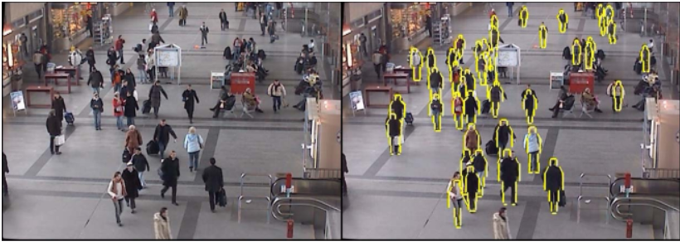
Motivation
Deformable contour tracking of pedestrian
Sensitive to initialization and noise
Detect object first and fit the active contour in local region
Notes:
Our goal is to tracking pedestrian by active contour instead of bounding box. However, fitting an active contour is not easy as putting a box around the object. Because the contour is very sensitive to initialization and noise. If the initialization contour is far from object, we can not guarantee it will converge into the contour of objects. So we can come up with a plan that we first detect object and fit the contour at that local region.

Slide 3
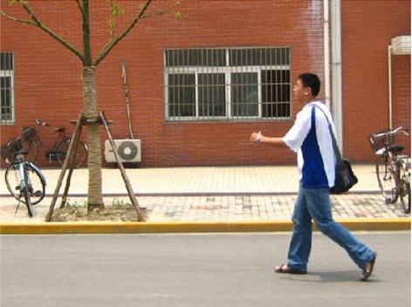


Method
Using deep learning to detect object and initialize a local region
Fit the active contour in local region with snake method

Slide 4
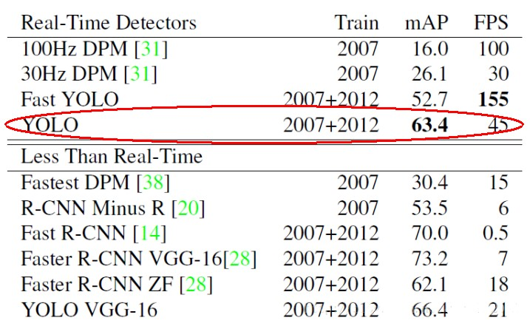
Method
Accuracy & Detection speed
Notes:
mAP: mean Average precision

Slide 5
Method
Find a suitable dataset
Augment the data set with a small scale labeled one
Training an YOLO network
Evaluation & Analysis
Data Collecting
Augmentation
Training NN
Evaluation

Slide 6

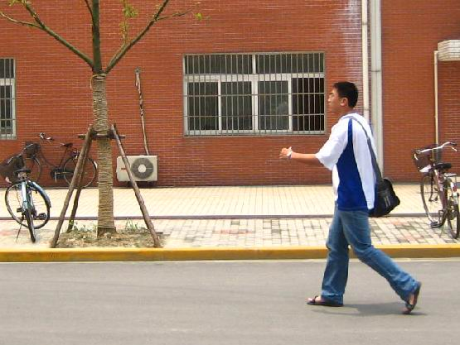
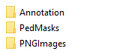
Data Collecting
Annotation
PedMasks (Ground truth of contour)
Original images
Files
Mask
Original images

Slide 7
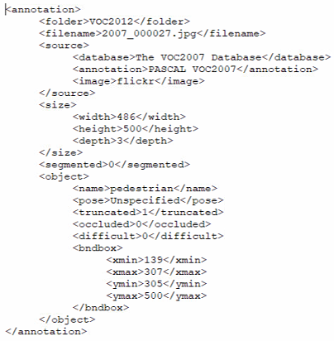
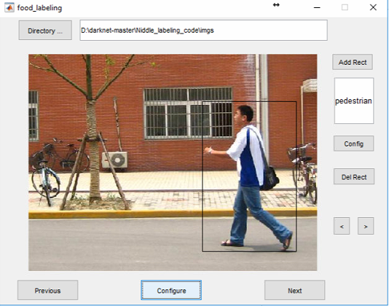
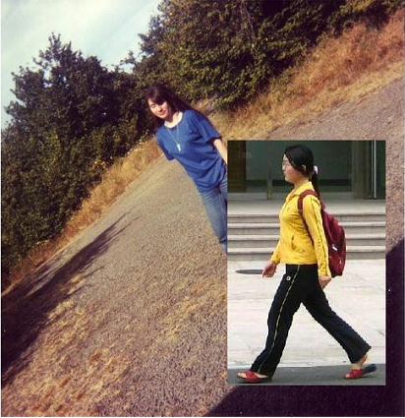
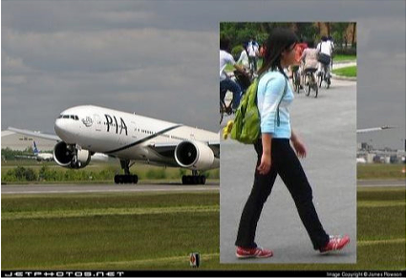
Augmentation
Select patches manually: 120 patches
Transform into VOC dataset format
Overlap patches into 5000 images selected from VOC dataset

Slide 8
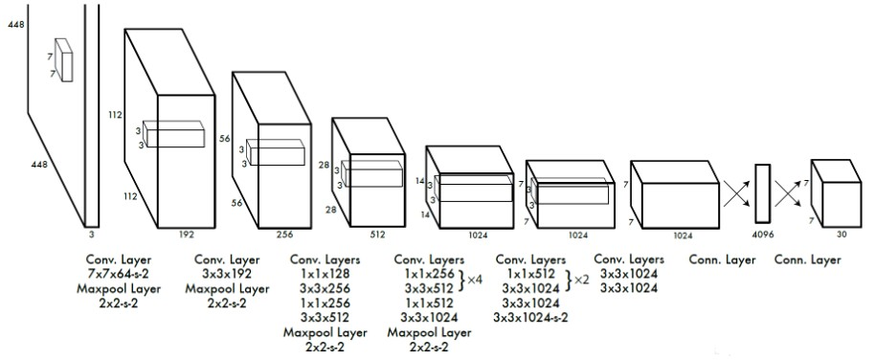
Training YOLO
You Only Look Once: Unified, Real-Time Object Detection
24 Conv. Layers & 2 FC Layers
Pre-trained ImageNet as the first 20 Conv. Layers, then add 4 randomly initialized Conv. Layers & 2 FC Layers.
Notes:
Go through the calculation of CNN once each time
Unified structure, provide end to end prediction
Detection speed is fast

Slide 9
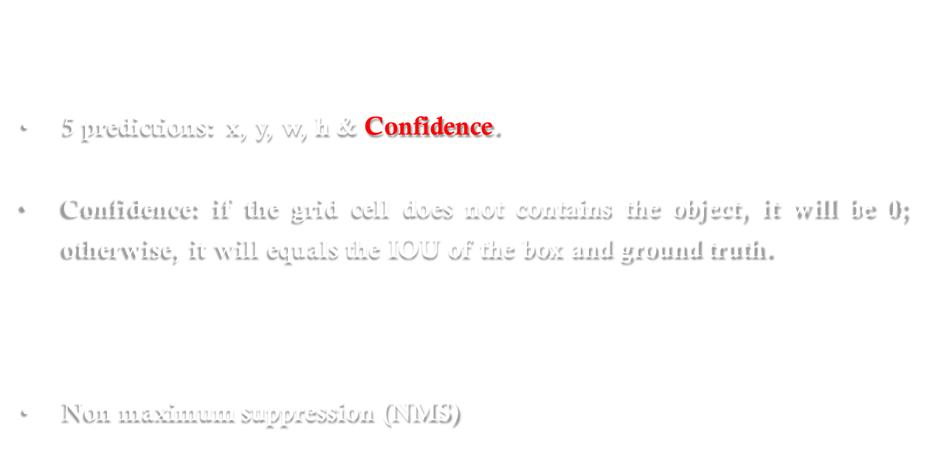

Bounding Box
The image is split into $S×S$ grid cells in each contains B bounding boxes.
5 predictions: x, y, w, h & Confidence.
Confidence: if the grid cell does not contains the object, it will be 0; otherwise, it will equals the IOU of the box and ground truth.
Non maximum suppression (NMS)
$$Pr\left(Object\right)∗{IOU}_{pred}^{truth}$$

Slide 10
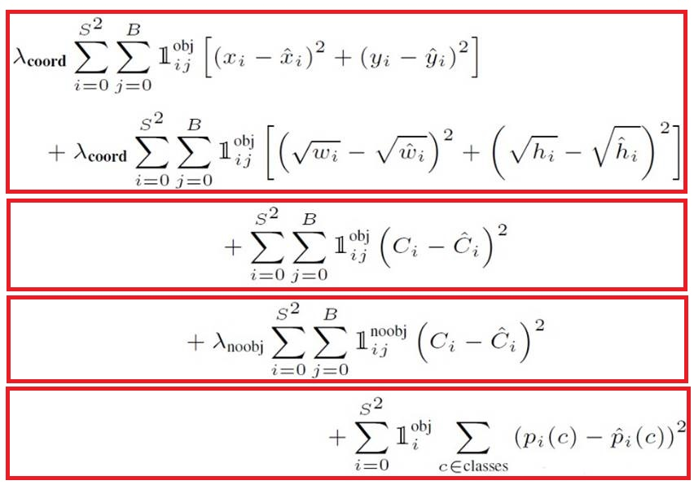
Loss Function
Prediction of coordinate position
Prediction of the confidence of the Bounding boxes containing objects
Prediction of the confidence of the Bounding boxes containing non-objects
Classification

Slide 11
Active contour (Snake)

Slide 12
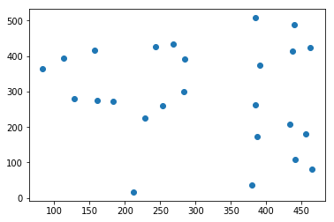
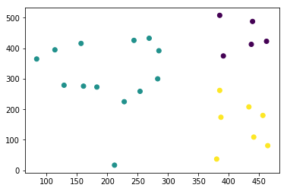
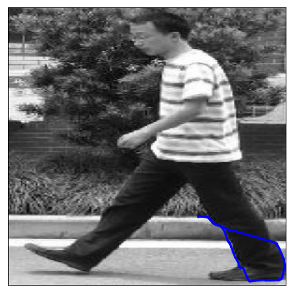
Notes:
1. External energy map; 2; find key points; 3. key points clustering; 4; fitting active contour for each cluster

Slide 13
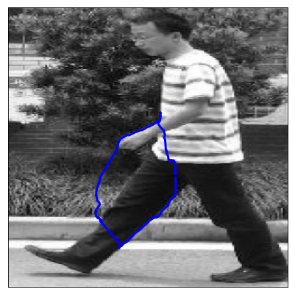

Slide 14
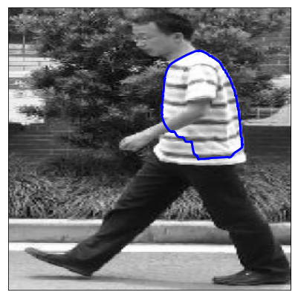

Slide 15
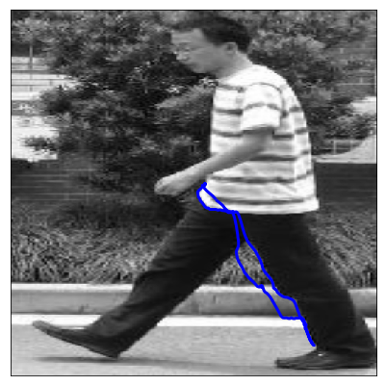

Slide 16
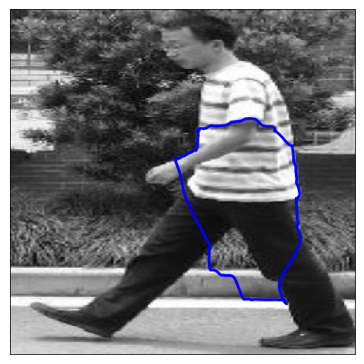

Slide 17
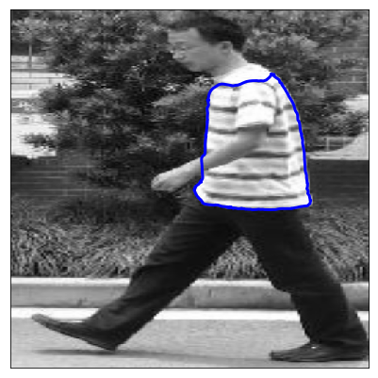

Slide 18

Notes:
Critical steps: key points; how many clusters; the value of alpha

Slide 19



Approach of updating snake
$$E_{total}={αE}_{tension}+{βE}_{stiffness}+{γE}_{external}$$
$$α_{↑}{ β}_{↓}{ γ}_{fixed}$$
$$α_{↑}{ β}_{fixed}{ γ}_{fixed}$$
$$α_{↓}{ β}_{fixed}{ γ}_{fixed}$$

Slide 20
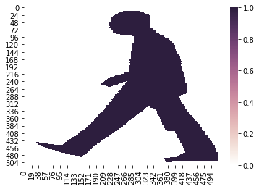
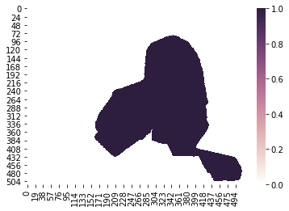
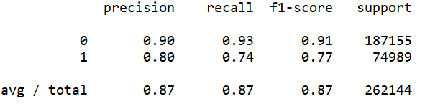
Evaluation

Slide 21
Thank You

